Slide 1
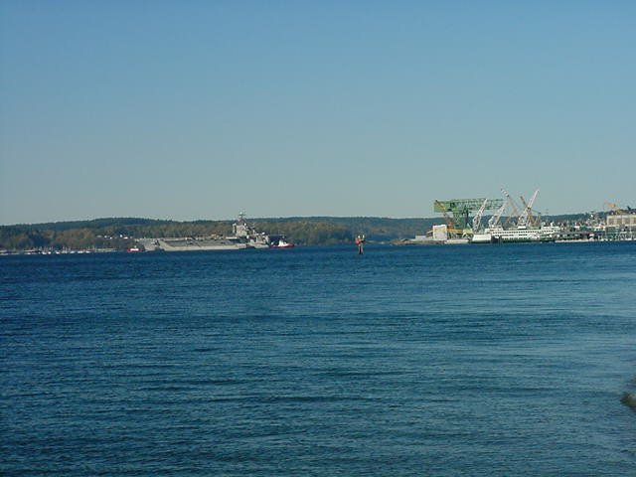
Ambient monitoring to inform the protection of beneficial uses and achieve water quality goals in Sinclair and Dyes Inlets, Puget Sound, WA Salish Sea Ecosystems Conference SSE3-260, Seattle, WA R. K. Johnston¹, M. J. Aylward², G. H. Rosen¹, M. Colvin¹, J. M. Brandenberger³, J. E. Strivens³, N. J. Schlafer³, and P. Caswell² 1. US Navy Space and Naval Warfare Systems Center Pacific 2. US Navy Puget Sound Naval Shipyard & Intermediate Maintenance Facility 3. Pacific Northwest National Laboratory
Outline of Talk
Bottom Line
Background
Partnering on the Watershed Scale
Improved Monitoring to Achieve Water Quality Goals
Ambient Monitoring and Toxicity Assessment
Mussel Watch
Conclusions
This presentation reflects the personal views of the authors and does not suggest or reflect the official policy, practices, programs, or doctrine of the U.S. Navy or any other governmental agency.
Notes:
Background is photo of USS Abraham Lincoln (CVN-72) coming into Puget Sound Naval Shipyard, Bremerton, WA for repairs in April 2001.
The Puget Sound Naval Shipyard & Intermediate Maintenance Facility (PSNS&IMF), the Environmental Protection Agency (EPA), the Washington State Department of Ecology (Ecology), and other local stakeholders are cooperating in an ENVironmental inVESTment (ENVVEST) project to develop and demonstrate alternative strategies for protecting and improving the ecological integrity of Sinclair and Dyes Inlets and their surrounding watershed in the Puget Sound, WA
Since the Final Project Agreement (FPA) was signed in September 2000, Project ENVVEST has leveraged model development and ecological research to conduct technical studies that are addressing impairments listed on the 1998 303(d) list for the watershed. Impairments are waterbodies that do not meet water quality standards and require a Total Maximum Daily Load (TMDL) study and water cleanup plan to achieve compliance.
The bacterial TMDL study addresses listings in the Inlets and tributary streams, the sediment TMDL studies are addressing numerous metal and toxic organic listings in the sediments of the Inlets, and ambient monitoring studies are helping to address tissue residue listings and document the quality of water and sediment in the Inlets. Future work may also address low dissolved oxygen in the Inlets. All work for Project ENVVEST was performed to support the development of a Phase II proposal to regulate discharges at PSNS&IMF. The Phase II proposal is intended to result in increased efficiency and/or effectiveness of the Shipyard’s environmental program.
Results have been spectacular. In addition to maintaining environmental compliance at the shipyard, the Project has fostered partnering with regulators and local stakeholders (cities, county, tribe, etc), accomplished cooperative monitoring and modeling studies, improved the shipyards’s public image, and achieved improvements in environmental quality of the Inlets. The work made significant contributions in the decision to reopen (for the first time in decades!) shellfish beds in Dyes Inlet to commercial and tribal shellfishing.

Slide 2
The goal of the Clean Water Act is to protect aquatic life, human health, and other beneficial uses AND environmental performance is measured based on meeting NPDES discharge limits; BUT meeting NPDES discharge limits has very little to do with achieving water quality goals for the Inlets.
THEREFORE effective monitoring of the receiving waters is needed to assess continuous process improvement and inform management decisions.
Notes:
Background is photo of USS Abraham Lincoln (CVN-72) coming into Puget Sound Naval Shipyard, Bremerton, WA for repairs in April 2001.
The Puget Sound Naval Shipyard & Intermediate Maintenance Facility (PSNS&IMF), the Environmental Protection Agency (EPA), the Washington State Department of Ecology (Ecology), and other local stakeholders are cooperating in an ENVironmental inVESTment (ENVVEST) project to develop and demonstrate alternative strategies for protecting and improving the ecological integrity of Sinclair and Dyes Inlets and their surrounding watershed in the Puget Sound, WA
Since the Final Project Agreement (FPA) was signed in September 2000, Project ENVVEST has leveraged model development and ecological research to conduct technical studies that are addressing impairments listed on the 1998 303(d) list for the watershed. Impairments are waterbodies that do not meet water quality standards and require a Total Maximum Daily Load (TMDL) study and water cleanup plan to achieve compliance.
The bacterial TMDL study addresses listings in the Inlets and tributary streams, the sediment TMDL studies are addressing numerous metal and toxic organic listings in the sediments of the Inlets, and ambient monitoring studies are helping to address tissue residue listings and document the quality of water and sediment in the Inlets. Future work may also address low dissolved oxygen in the Inlets. All work for Project ENVVEST was performed to support the development of a Phase II proposal to regulate discharges at PSNS&IMF. The Phase II proposal is intended to result in increased efficiency and/or effectiveness of the Shipyard’s environmental program.
Results have been spectacular. In addition to maintaining environmental compliance at the shipyard, the Project has fostered partnering with regulators and local stakeholders (cities, county, tribe, etc), accomplished cooperative monitoring and modeling studies, improved the shipyards’s public image, and achieved improvements in environmental quality of the Inlets. The work made significant contributions in the decision to reopen (for the first time in decades!) shellfish beds in Dyes Inlet to commercial and tribal shellfishing.

Slide 3
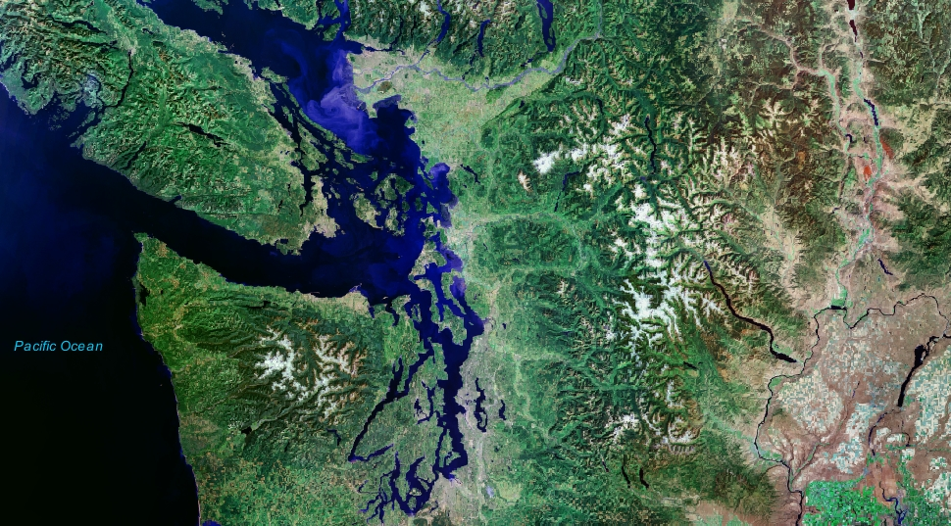
You Are Here
Sinclair and Dyes Inlets

Slide 4
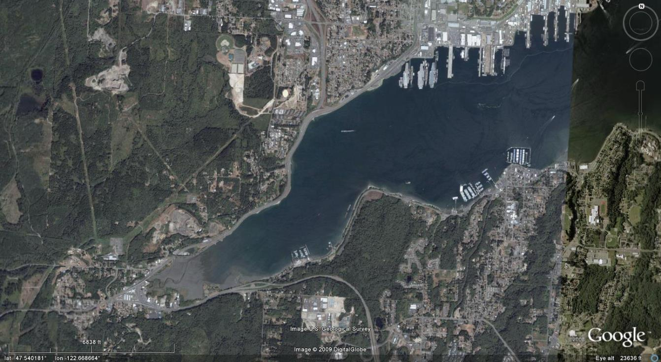

Main Sources of Impact
Historical releases of pollutants
Past practices (Point Sources)
Legacy residual contamination
Watershed Development
Loss of natural habitat
Increases in runoff from landscape
More Nonpoint Source Pollution
(Google Earth 2009)

Slide 5
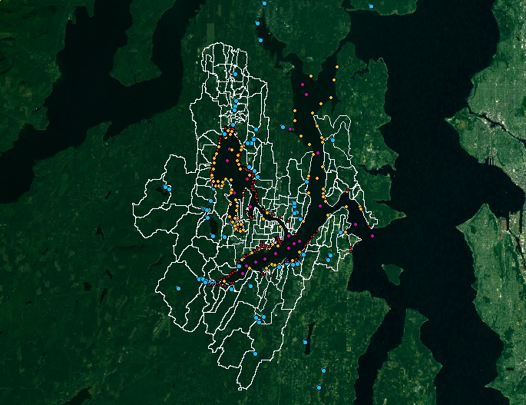
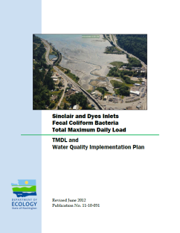
Partnering at the Watershed Scale
The watershed scale is the appropriate scale to address problems and engage stakeholders
ENVironmental InVESTtment
(ENVVEST)
Navy
EPA
Ecology
Stakeholders
Nearshore
Notes:
5

Slide 6
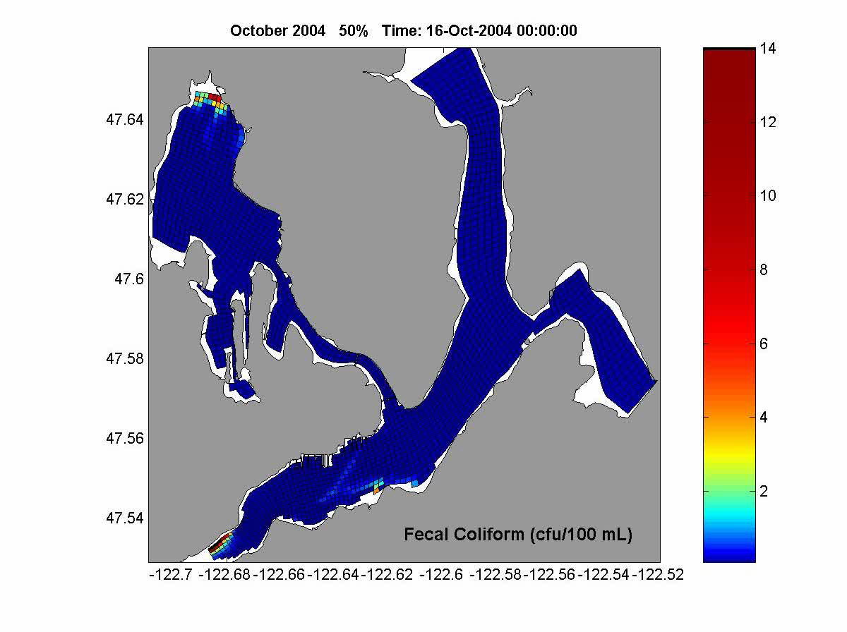
ENVVEST Partnership Modeling
Simulation of Oct 2004 Storm Event
Color scale shows build up of contamination near creek mouths and nearshore areas with limited flushing
Upset condition occurred at Port Orchard treatment plant (10/19/04 10:00)
Effect of upset evident throughout Inlets
Short term effect as contamination is reduced by dispersion, mixing, and die off of harmful bacteria

Slide 7
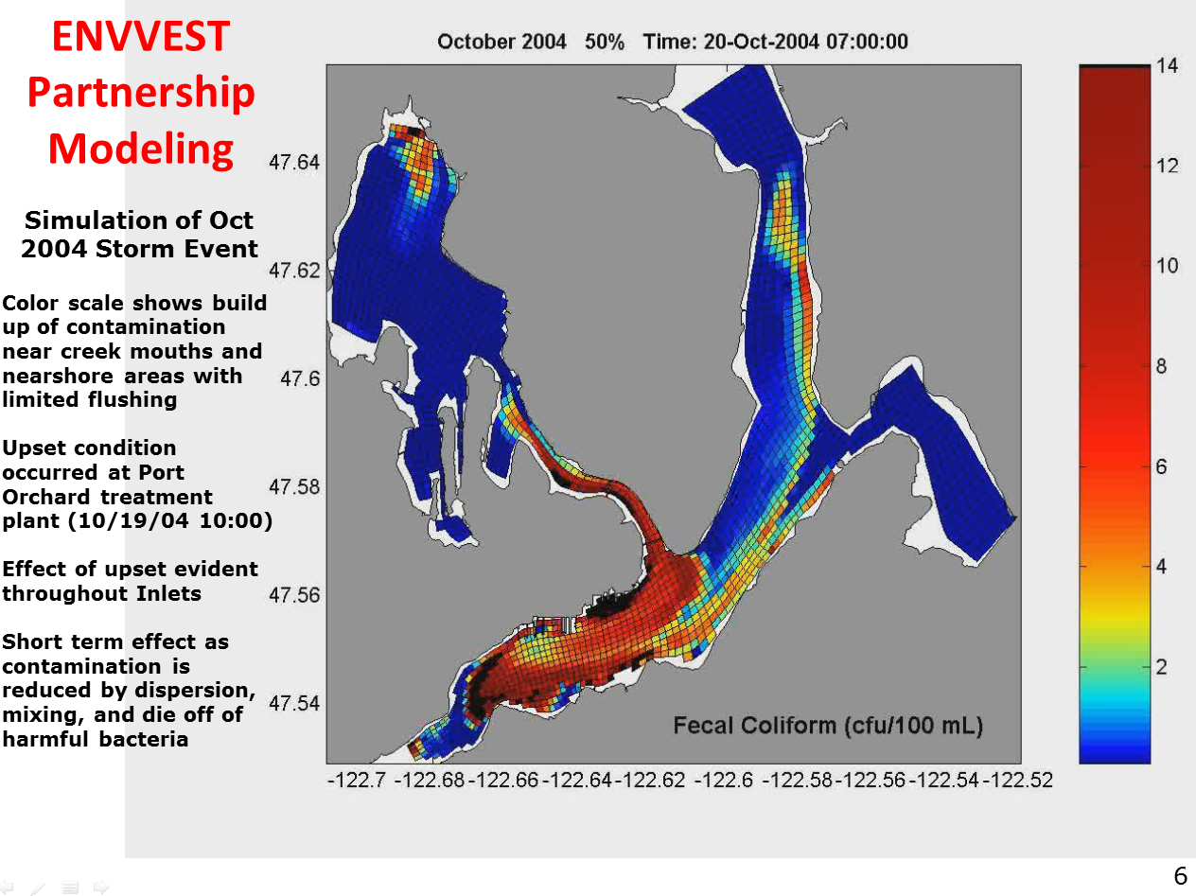

Slide 8
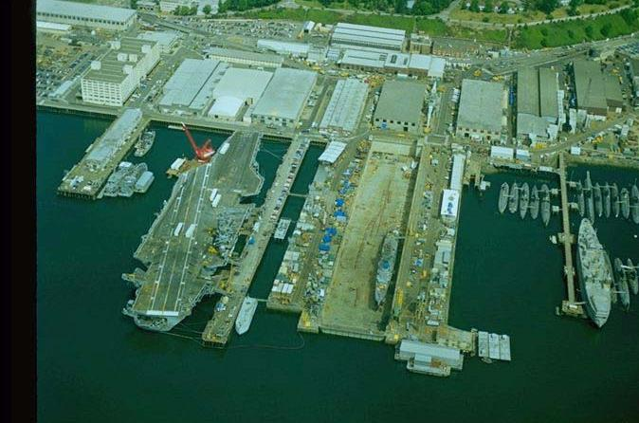
PSNS & IMF (Bremerton)
Shipyard Operation May 1992
(WA Dept. of Ecology Shoreline Photo)
Continuous Process Improvement!
Notes:
8
Images:
Ecology Shoreline photo from May 1992

Slide 9
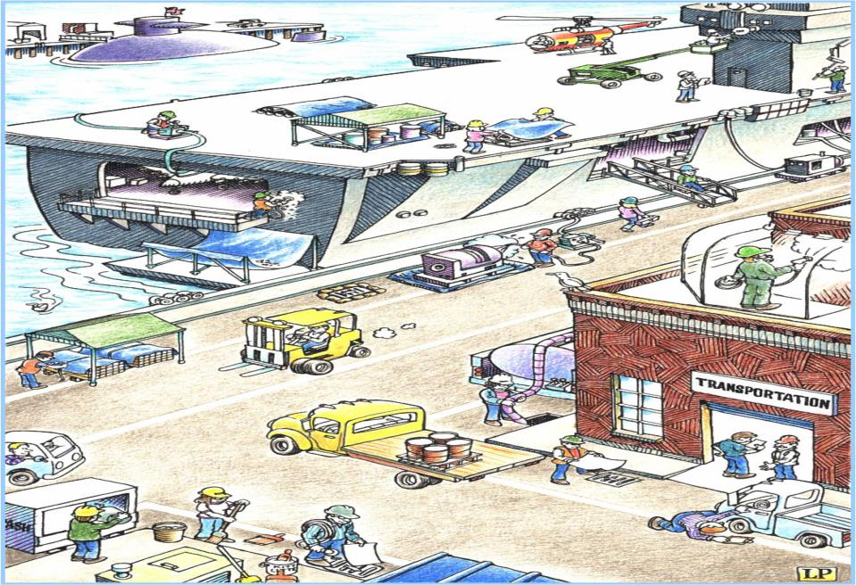
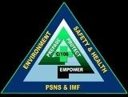

Water pollution BMPs
WATER POLLUTION PREVENTION BMPs
Outdoor Metal Work
Drip Pans
Material Storage & Handling
Overwater Work
Equipment Cleaning
Containment
Storm Drains
Treated Wood Products
Storm System Maintenance
Work Area Cleaning
Vehicle Maintenance
Outdoor Work
Loading/Unloading
Notes:
The Clean Water Act specifies Best Management Practices (BMPs) as one method, among others, to prevent or minimize water pollution. The Shipyard's National Pollutant Discharge Elimination System (NPDES) permit requires us to develop and implement BMPs. Violations can result in civil or criminal penalties. The current BMPs were developed specifically for Shipyard activities that contribute pollutants to Sinclair Inlet through both storm water and dry dock discharges.
BMPs are work practices used to prevent or reduce water pollution from any type of activity. BMPs are a very broad class of work practices and may include processes, procedures, and prohibition on practices to prevent or reduce water pollution. BMPs can be just about anything that "do the job" of preventing toxic or hazardous substances from entering the environment.
Please do your part to keep Sinclair Inlet clean, for yourself and for future generations.
YARD CLEANUP: Remove debris to minimize loss into Sinclair Inlet or storm drains. Do not use wet methods for cleaning without Code 106.32 approval.
Containers that hold OAS liquids shall be stored with tight fitting lids and containers 55 gallons or greater shall be stored in secondary containment.
Cover/contain stockpiles of raw materials. Cover sandblast grit, petroleum contaminated material, lead, brass, bronze, copper wire, and welding debris whether in bins or on pallets.
Contain debris from activities that generate pollutants. Perform spray painting inside enclosures.
Use drip pans or secondary containments when transferring oil, fuel, solvent, industrial wastewater, or paint. Immediately repair/replace or isolate leaking connections.
Government vehicles must be checked for leaks before use. Maintain vehicles in good condition, conduct routine maintenance and repair of vehicles in a building or other area out of way of storm water.
Cover storm drains when loading/unloading liquids and fine granulated materials from trucks.
Conduct all work over water in such a way to prevent pollutants from entering water. Roller paint pans must have a secondary containment, spray painting must be contained, hand preparation such as scraping, needle gunning or wire brushing are allowed provided all debris is collected. Power tool preparation producing dust or contaminated water must be fully contained.
Do not discharge anything into storm drains unless authorized by Code 106.32.
SHIPYARD & DRY-DOCK CLEANUP- Clean trash, debris, and dirt from storage, work areas and catch basins to prevent it from washing into storm drains and surface water. Use dry methods (e.g. sweep, shovel, or vacuum) do not hose down unless approved by Code 106.3. Clean dry-dock at the end of the shift.
STORM SEWER CLEANING AND MAINTENANCE - Clean catch basins when the depth of deposits are equal to or greater than 1/3 the depth from the basin to the invert of the lowest pipe into or out of the basin. Inspect catch basins to determine frequency of cleaning. The Shop or Code responsible for the cleanliness of those assigned areas will accomplish those inspections. The receiving Shop will be responsible for loading/unloading areas at building doors or loading docks.

Slide 10
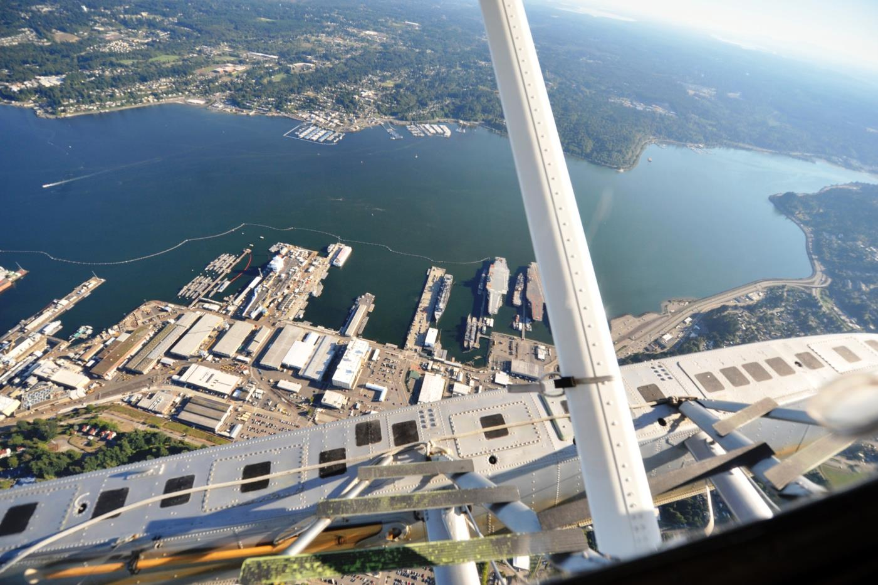
Eyes over Puget Sound
Eyes over Puget Sound
9/11/2013
(WA Dept. of Ecology)
Continuous Process Improvement Is Working!
Notes:
Ecology Eyes Over Puget Sound (EOPS) Photo
http://www.ecy.wa.gov/programs/eap/mar_wat/surface.html

Slide 11
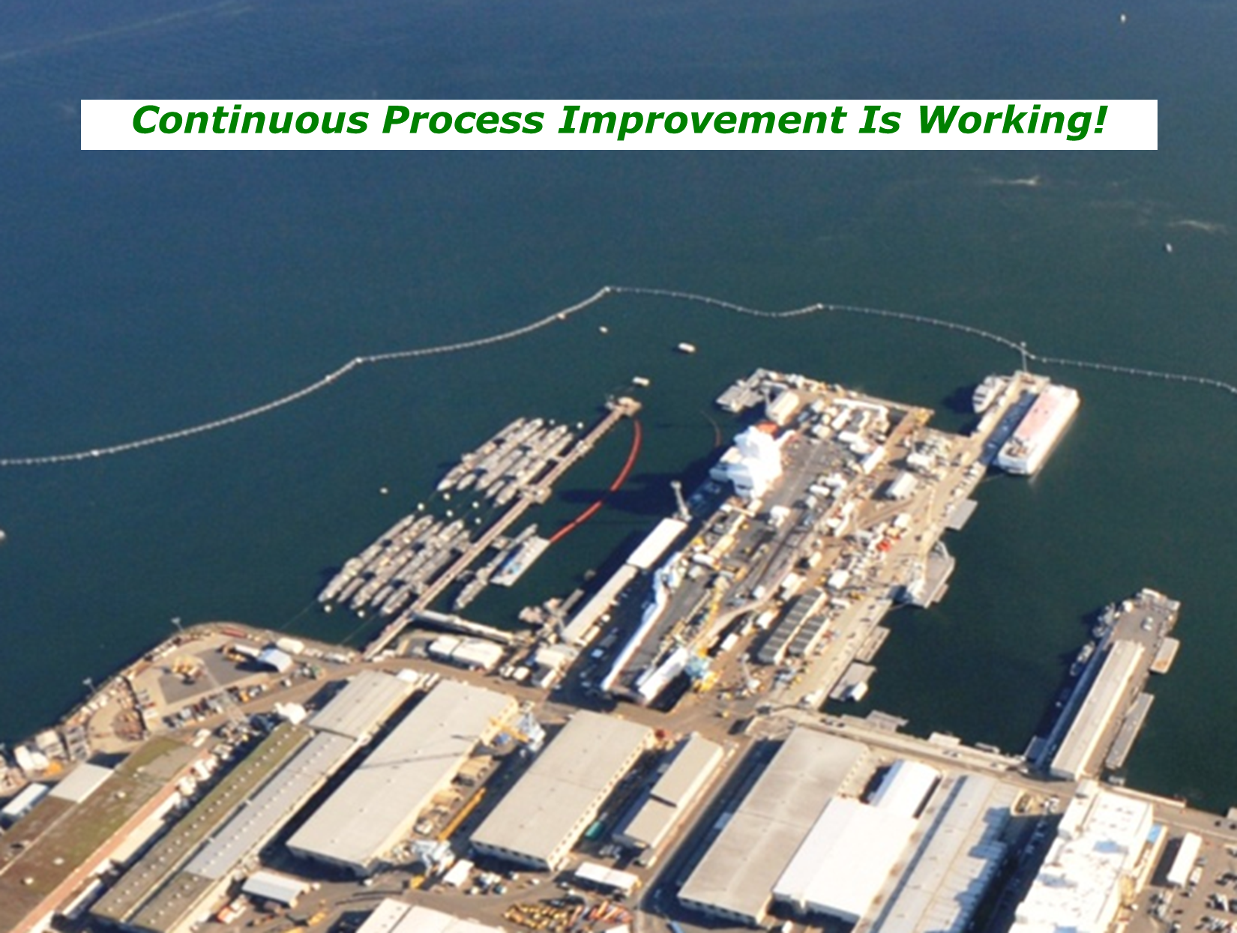
Eyes over Puget Sound
Eyes over Puget Sound
9/11/2013
Eyes over Puget Sound
9/11/2013
(WA Dept. of Ecology)
Continuous Process Improvement Is Working!
Notes:
Ecology Eyes Over Puget Sound (EOPS) Photo
http://www.ecy.wa.gov/programs/eap/mar_wat/surface.html

Slide 12
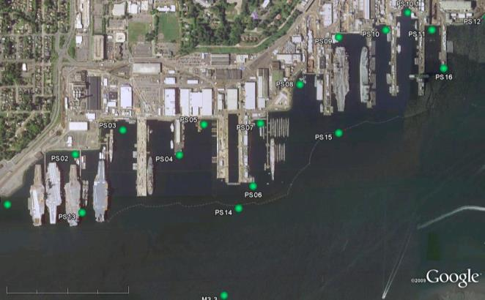
Ambient Monitoring and Toxicity Testing
What - Monthly and storm event sampling for fecals; seasonal sampling for metals and toxicity; Mussel sampling on even years
OF18
OF19
OF21
Receiving Water
Outfall Discharge

Slide 13
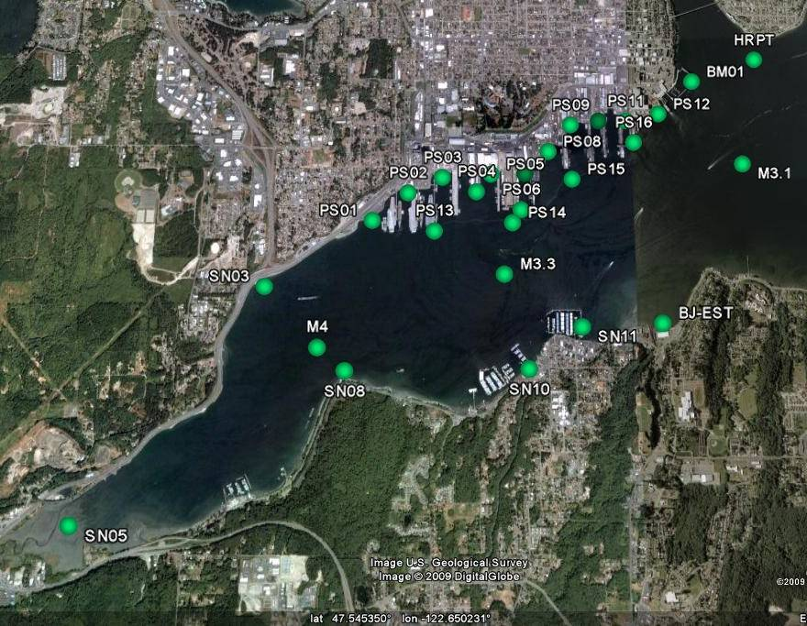
Ambient Marine Stations – Sinclair Inlet
WWTP
WWTP
Wright Cr
Blackjack Cr
Ross Cr
Gorst Cr
Tox Samples
Stream
Stormwater
WWTP
Anderson Cr

Slide 14
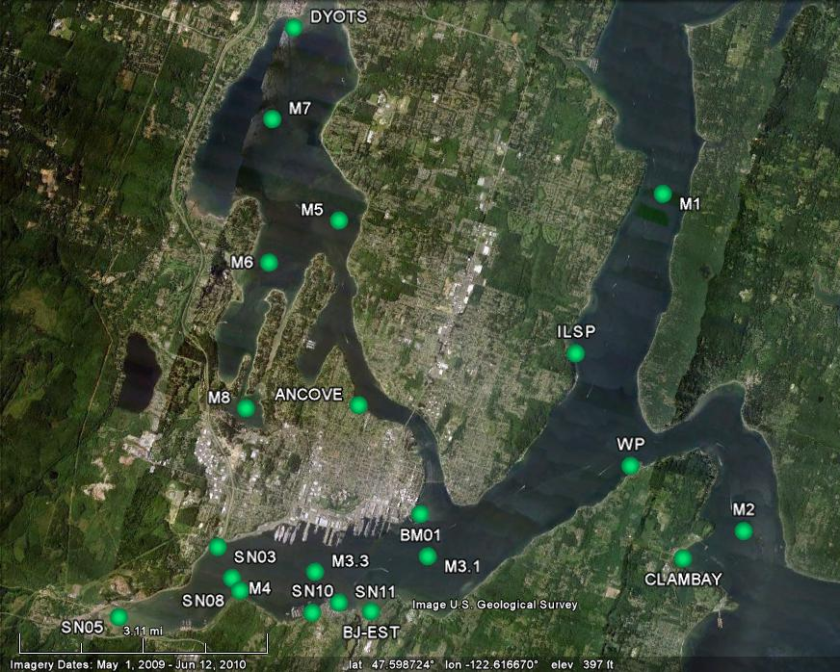
Ambient Marine Stations – Dyes Inlet and Passages
Strawberry Cr
Clear Cr
Barker Cr
Springbrook Cr
Chico Cr
Illahee Cr
Stream
Stormwater
WWTP
WWTP
Beaver Cr

Slide 15
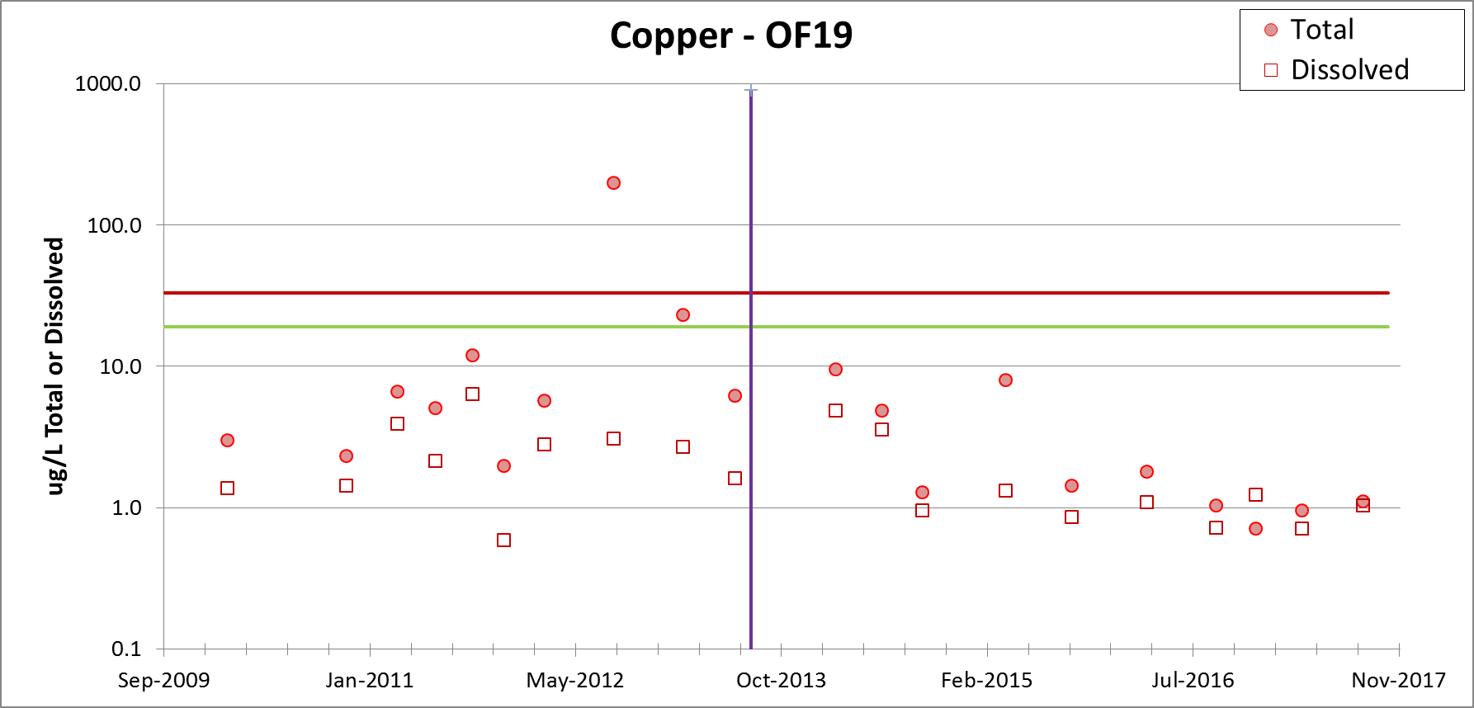
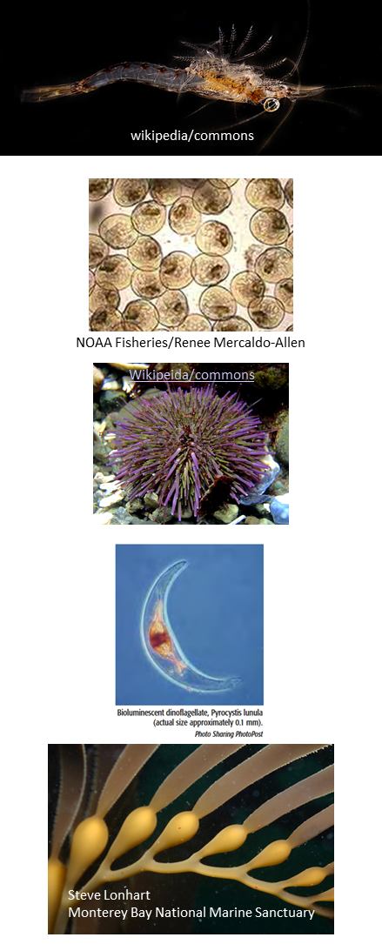
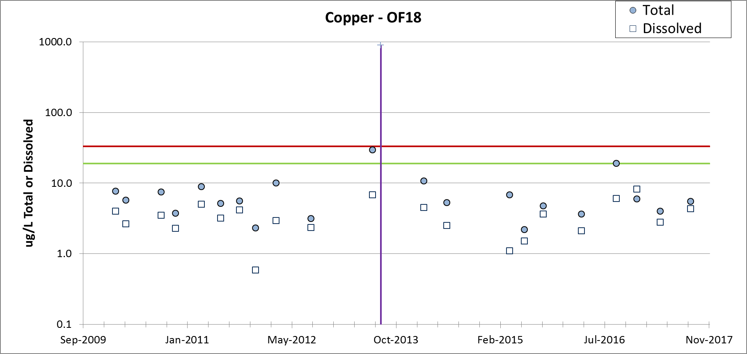
Effluent Monitoring
Dry Dock Improvements Complete
Daily Max
24 hr Composite
Trace Metal Analysis using ultra clean seawater methods
Whole Effluent Toxicity (WET) Testing
Monthly Avg

Slide 16
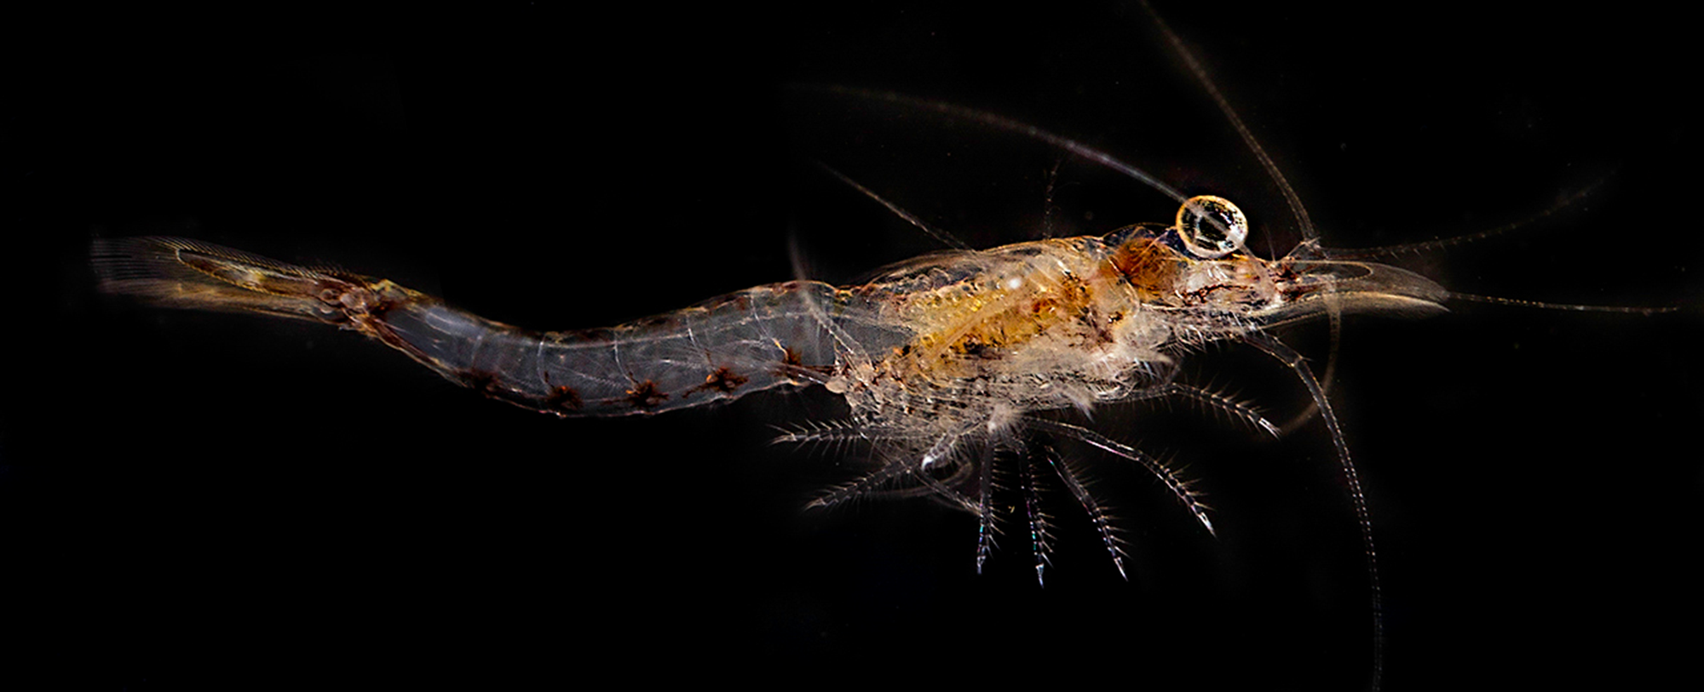
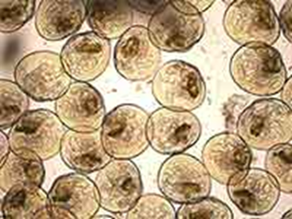
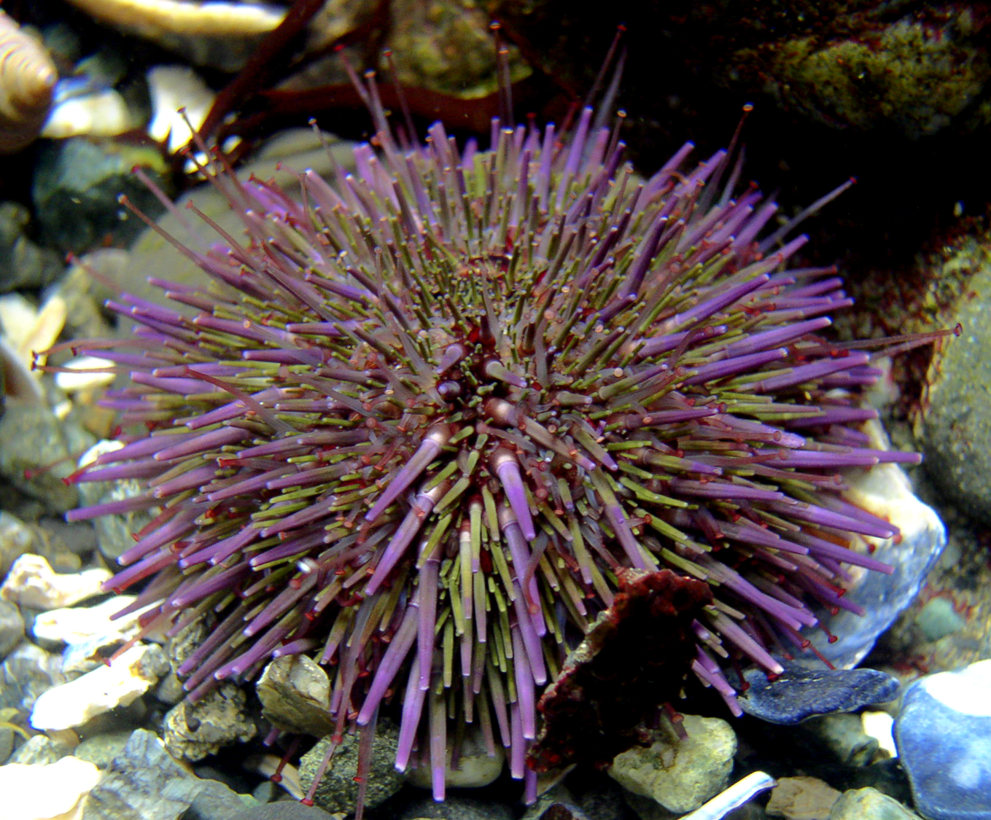
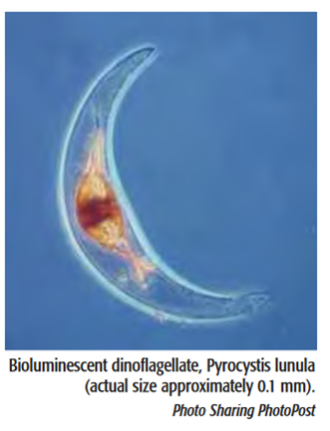
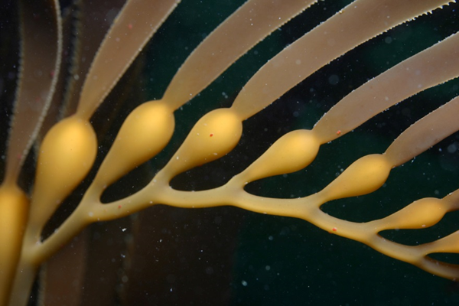
Toxicity Testing
Acute Toxicity Test:
96 hr Mysid Survival
Chronic Toxicity Tests:
48 hr Mussel Larvae Development**
96 hr Sea Urchin Larvae Development
24 hr QwikLite (Bioluminescence Response)
48 hr Giant Kelp Germination and Growth
**Driver for national saltwater WQC for copper
wikipedia/commons
NOAA Fisheries/Renee Mercaldo-Allen
Wikipeida/commons
Steve Lonhart
Monterey Bay National Marine Sanctuary
Notes:
The acute testing with mysids evaluates survival at the end of a 96 hr exposure period.
The chronic testing with the other organisms evaluate sub-lethal endpoints including growth of organisms, embryo larval development, spore germination and growth or bioluminescence for example.

Slide 17
 | AMB17 | AMB18 | AMB19 | AMB20 |  | AMB17 | AMB18 | AMB19 | AMB20 |  | AMB17 | AMB18 | AMB19 | AMB20
 | NPDES18 |  |  |  |  | PS08 |  |  |  |  | M4
MysidSurv | 0.00 | 0.00 | 5.00 | 0.00 |  | 0.00 | 15.00 | 0.00 | 0.00 |  | 0.00 | 5.00 | 0.00 | 0.00
SeaUrchin | 9.27 | 67.01 | 93.63 | 85.66 |  | 0.00 | 0.00 | 4.26 | 1.62 |  | 0.20 | 0.00 | 0.60 | 0.00
QwikLite | 11.11 | 19.59 | 26.94 | 41.22 |  | 0.00 | 0.00 |  | 0.00 |  | 0.00 | 0.00 | 0.00 | 22.22
MusDev |  |  |  |  |  |  | 0.00 |  |  |  |  | 0.31
MusNorSur |  |  |  |  |  |  | 7.44 |  |  |  |  | 0.00
 | NPDES19 |  |  |  |  | PS09 |  |  |  |  | BJ-EST
MysidSurv | 0.00 | 0.00 | 0.00 | 0.00 |  | 0.00 | 0.00 | 5.00 | 0.00 |  | 0.00 | 0.00 | 0.00 | 0.00
SeaUrchin | 0.00 | 1.09 | 14.93 | 0.00 |  | 0.00 | 0.73 | 0.81 | 0.81 |  | 1.00 | 0.45 | 0.60 | 0.00
QwikLite | 36.92 | 0.00 | 0.00 | 0.00 |  | 0.00 | 0.00 | 0.00 | 13.78 |  | 0.00 | 0.00 | 7.53 | 18.06
MusDev |  | 7.97 |  |  |  |  | 0.00 |  |  |  |  | 0.00
MusNorSur |  | 8.24 |  |  |  |  | 6.60 |  |  |  |  | 0.00
 | NPDES21 |  |  |  |  | PS14
MysidSurv | 0.00 | 10.00 | 10.00 | 0.00 |  | 0.00 | 5.00 | 0.00 | 0.00
SeaUrchin | 0.20 | 1.64 | 0.00 | 0.00 |  | 0.00 | 1.04 | 0.00 | 0.00
QwikLite | 25.84 | 4.31 | 1.85 | 0.63 |  | 0.00 | 0.00 | 0.25 | 17.86
MusDev |  | 0.64 |  |  |  |  | 0.00
MusNorSur |  | 3.04 |  |  |  |  | 1.26
 | PS01 |  |  |  |  | PS15
MysidSurv | 0.00 | 0.00 | 0.00 | 0.00 |  | 0.00 | 5.00 | 5.00 | 0.00
SeaUrchin | 0.00 | 0.00 | 0.00 | 0.00 |  | 0.20 | 2.49 | 0.80 | 0.00
QwikLite | 0.00 | 0.00 | 0.00 | 0.00 |  | 10.84 | 0.00 | 0.00 | 0.00
MusDev |  | 0.00 |  |  |  |  | 0.00
MusNorSur |  | 10.48 |  |  |  |  | 0.00
 | PS03 |  |  |  |  | M3.1
MysidSurv | 0.00 | 0.00 | 5.00 | 0.00 |  | 0.00 | 10.00 | 5.00 | 0.00
SeaUrchin | 0.00 | 0.21 | 0.00 | 0.00 |  | 1.20 | 8.65 | 0.60 | 0.00
QwikLite | 0.00 | 0.00 | 0.71 | 0.00 |  | 0.00 | 0.00 | 0.00 | 19.44
MusDev |  | 0.00 |  |  |  |  | 0.00
MusNorSur |  | 6.50 |  |  |  |  | 0.00
Relatively low toxicity observed for 2015-2016 events
OF18 has majority of significant hits in the urchin development test and the QL test

Slide 18
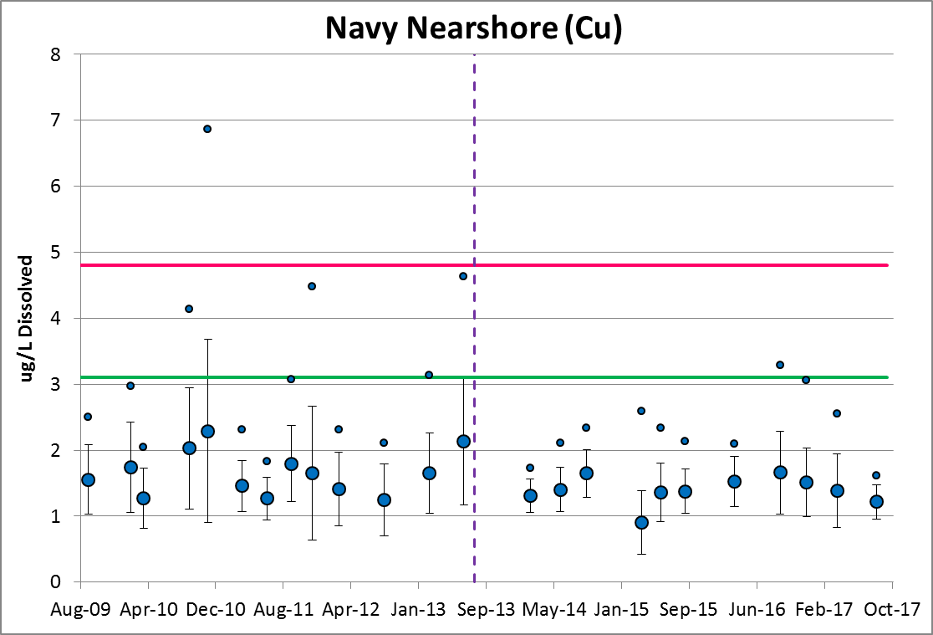
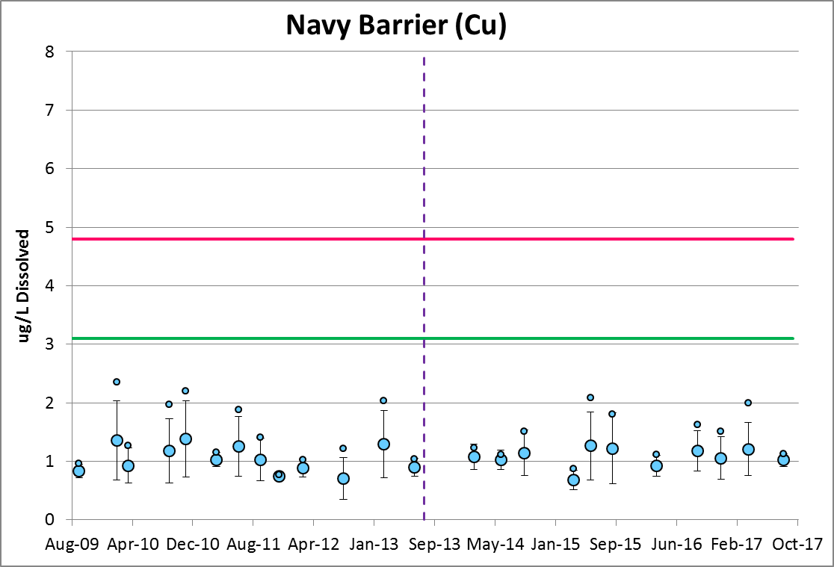
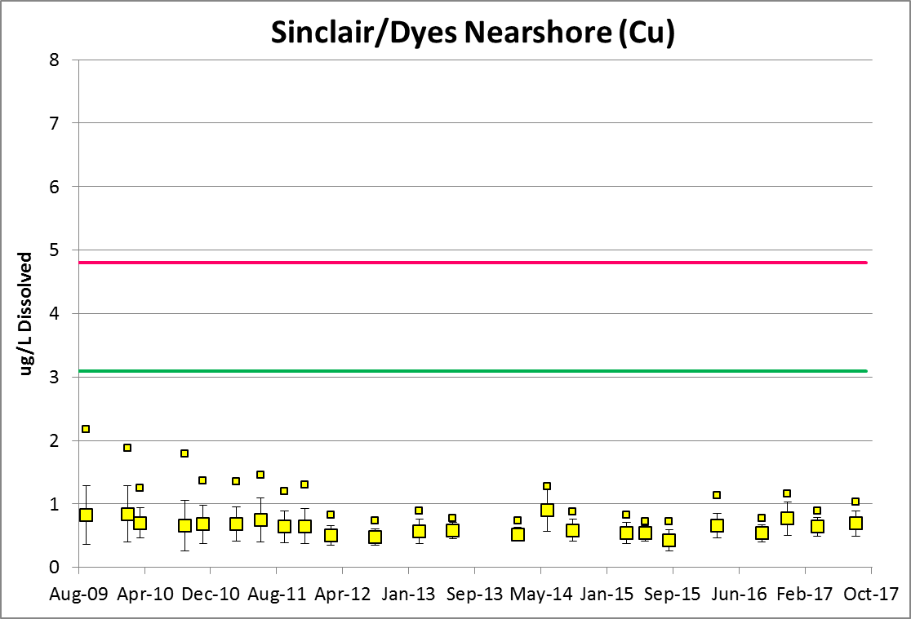
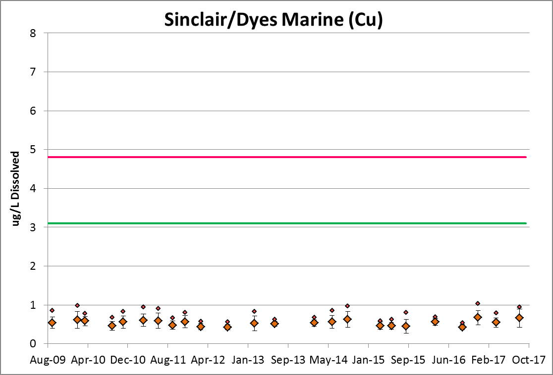
Ambient Monitoring Dissolved Copper
Dry Dock Improvements Complete
Acute
Chronic

Slide 19
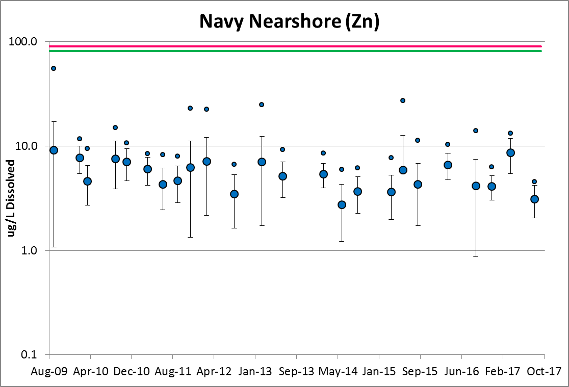
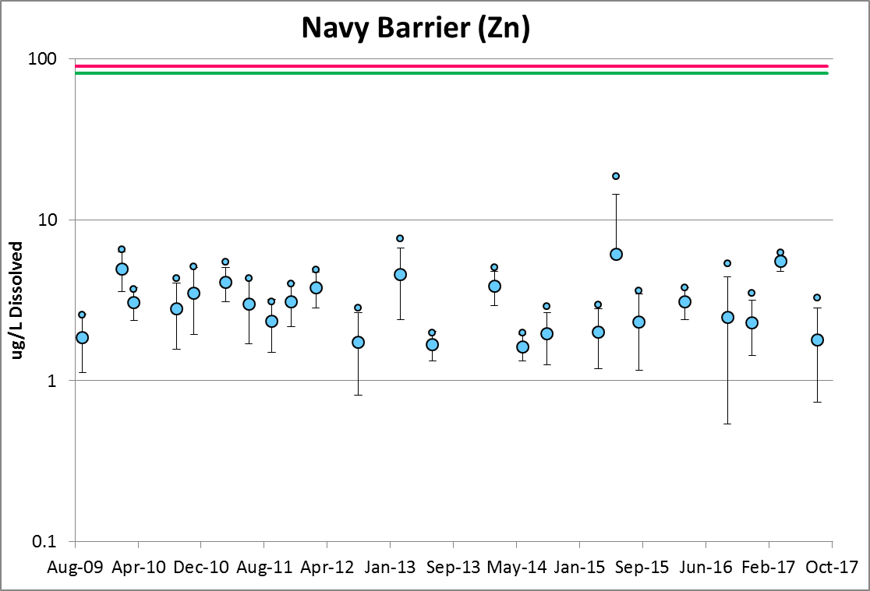
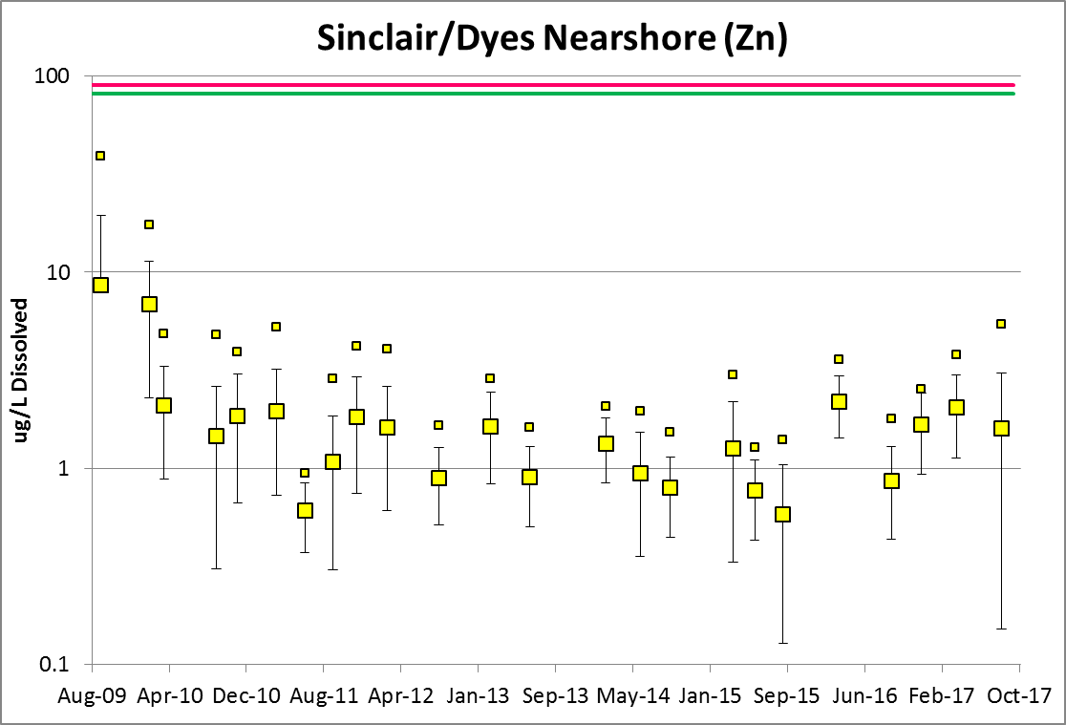
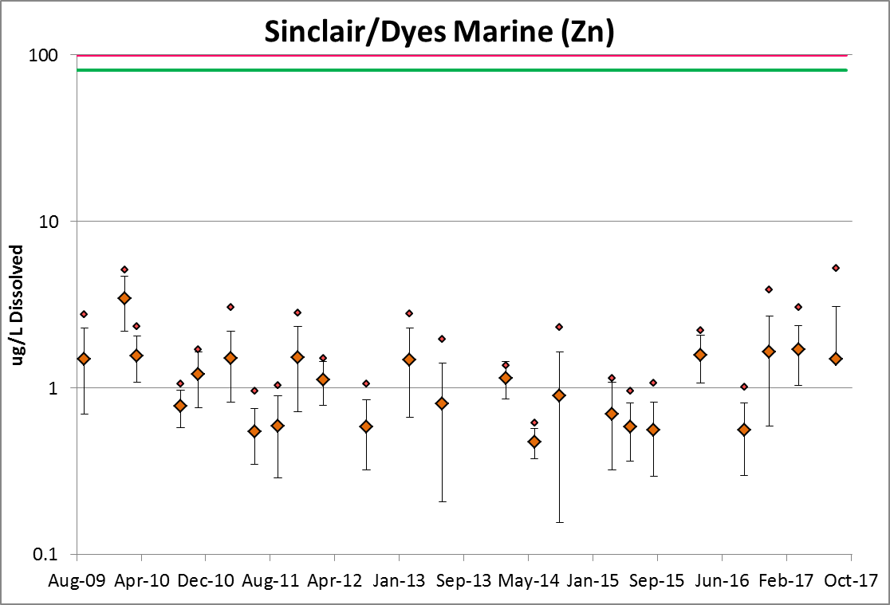
Ambient Monitoring Dissolved Zinc
Acute
Chronic

Slide 20
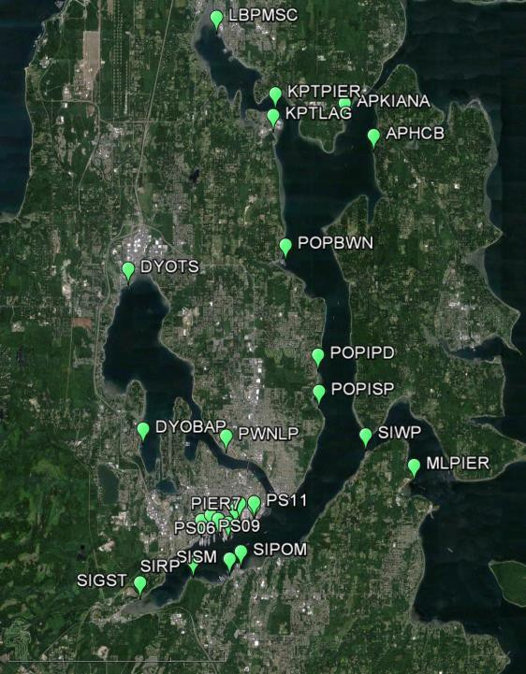
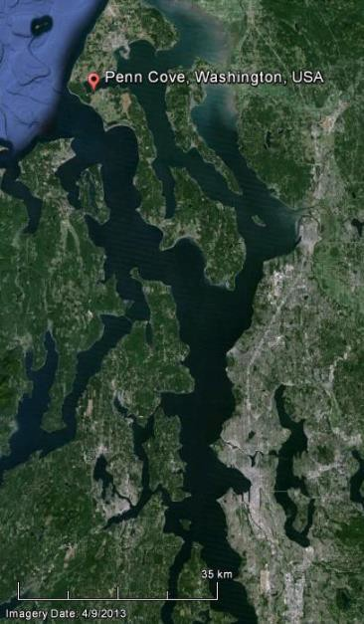
ENVVEST Mussel Watch
Stations 2010 - 2016
Participating Jurisdictions City of Bremerton Parks & Rec City of Bainbridge Island
Port of Bremerton Port of Brownsville Port of Illahee
Port of Poulsbo Port of Silverdale Private Landowner Suquamish Tribe
US EPA/NOAA Manchester Lab US Navy Naval Base Kitsap
US Navy Naval Underwater Weapons Center
US Navy Puget Sound Naval Shipyard & IMF
Washington Department of
Fish and Wildlife Washington State Parks Illahee
(Johnston et al. 2015, ENVVEST 2015)

Slide 21
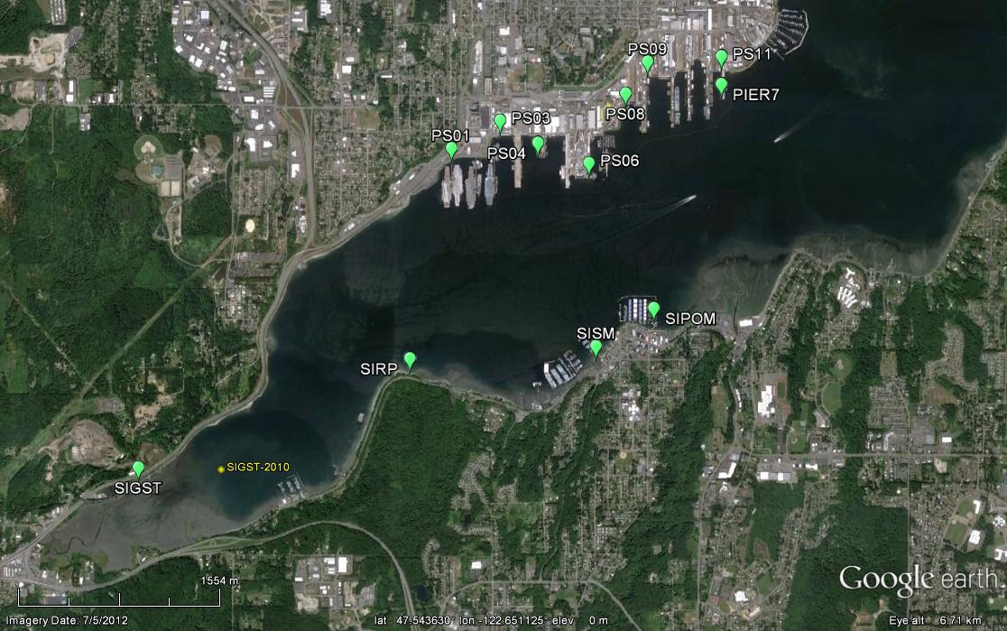
Mussel Watch Sinclair Inlet

Slide 22
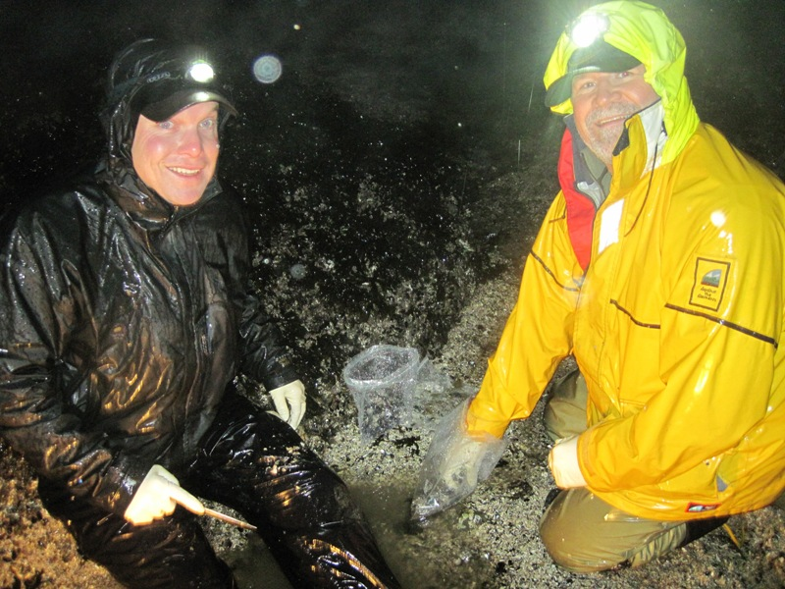
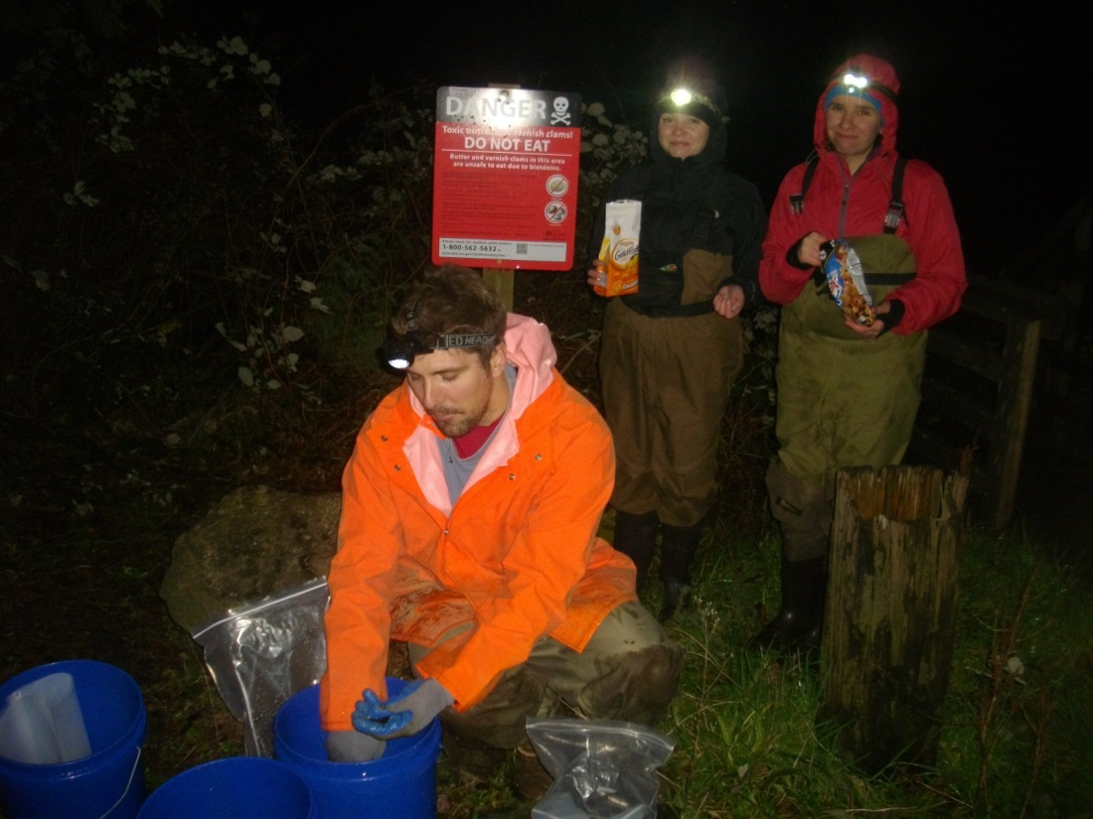
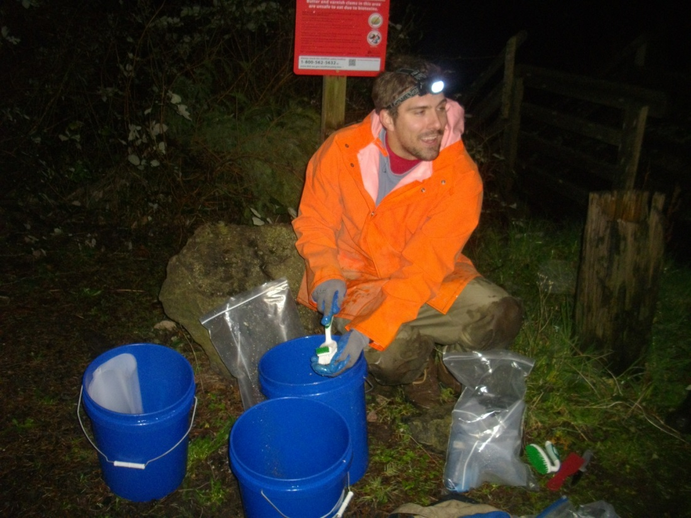
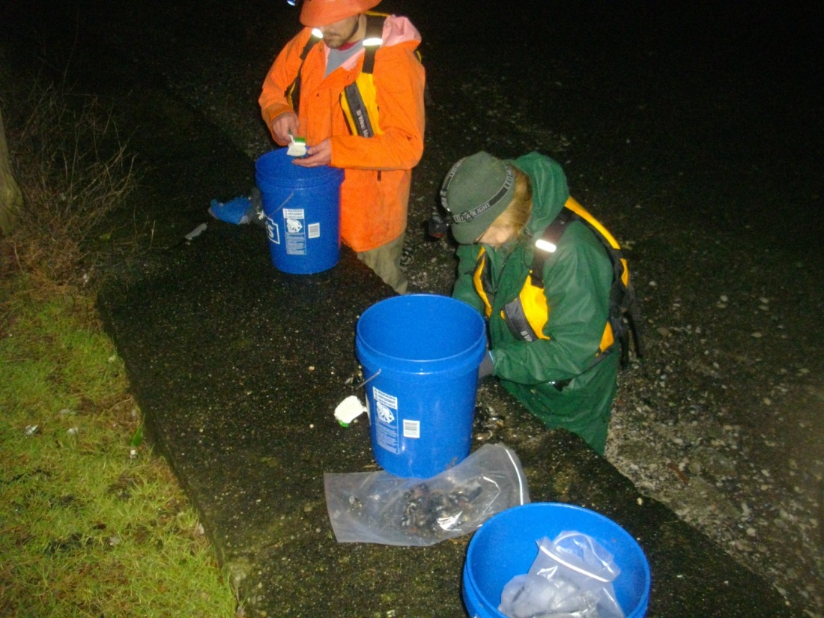
Mussel Watch Sampling

Slide 23
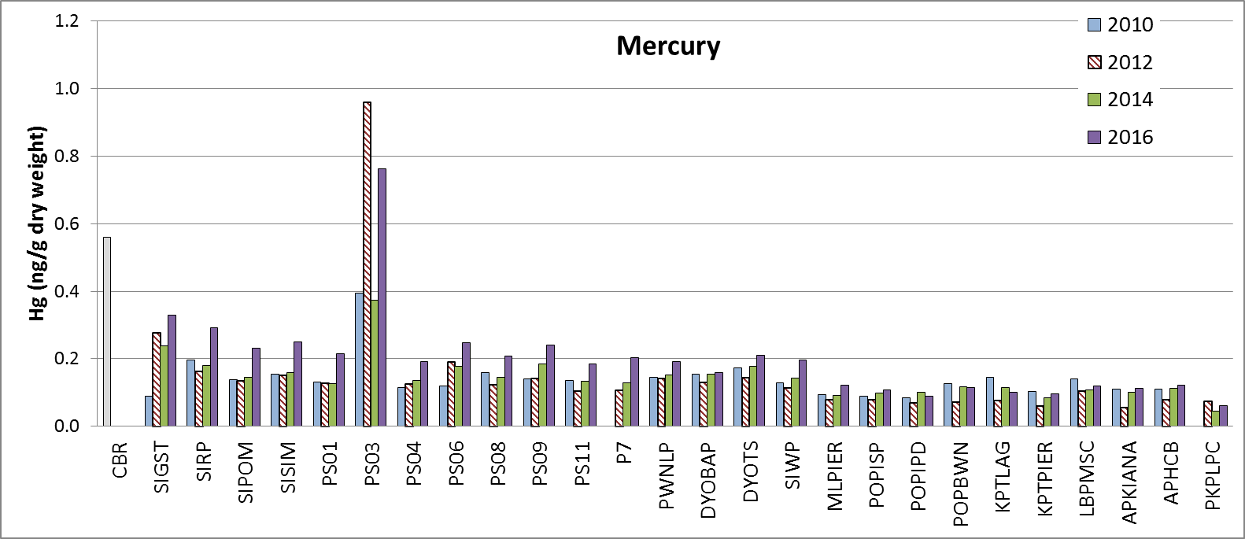
Mercury in Mussel Tissue
Sinclair Inlet
Navy Nearshore
Dyes I.
Passages/Liberty Bay
Hg (μg/g dry weight)
Critical
Body
Residue
Seafood Market
(Penn Cove,
Whidbey Island)

Slide 24
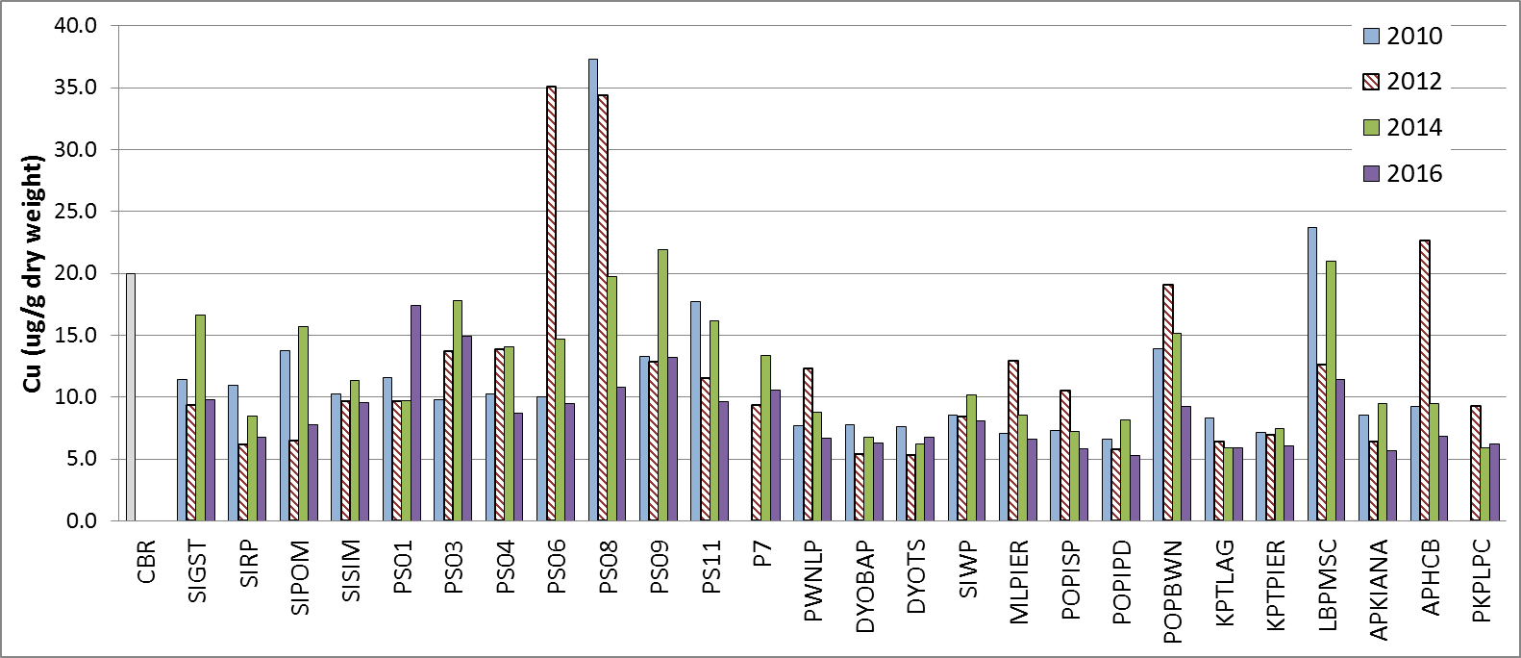
Copper in Mussel Tissues
Sinclair Inlet
Navy Nearshore
Dyes I.
Passages/Liberty Bay

Slide 25
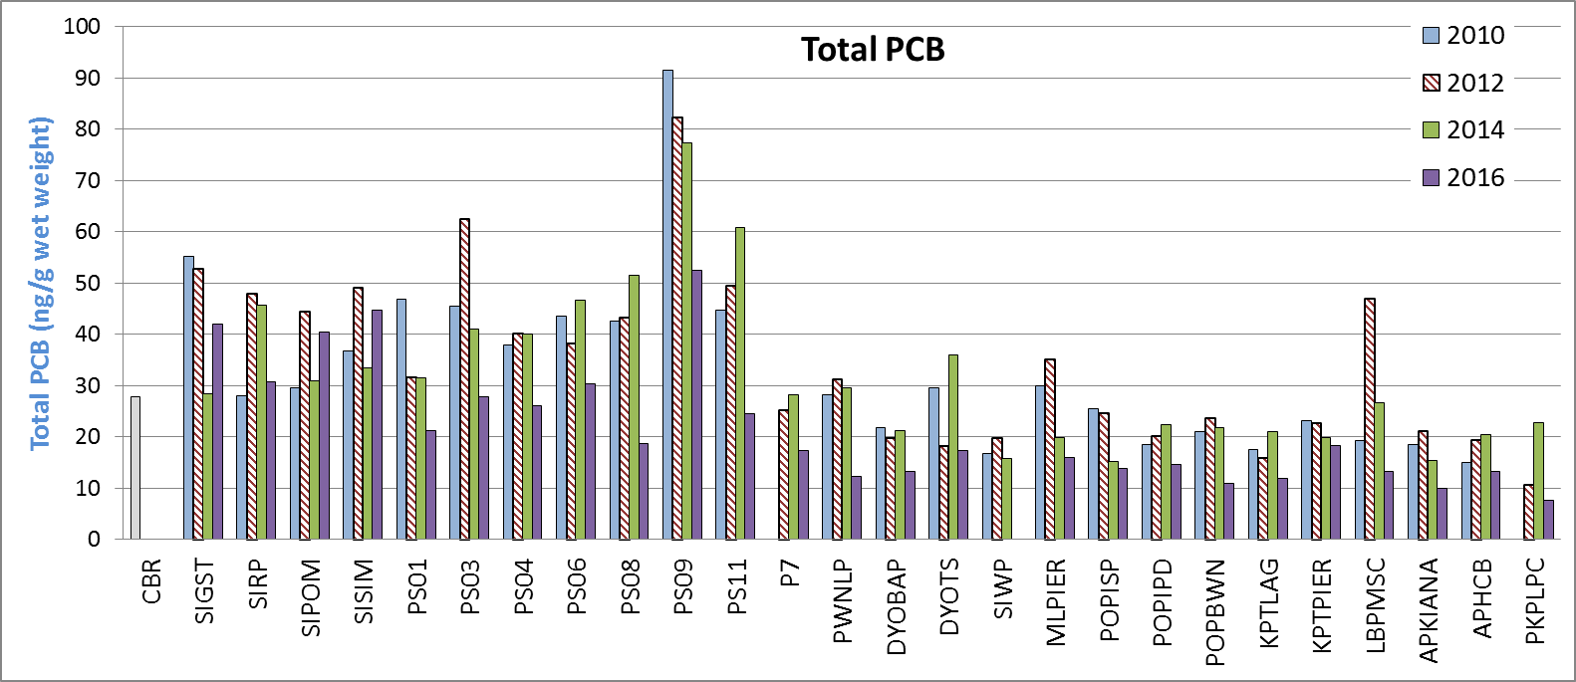
Total PCBs – Polychlorinated Biphenyls
Sinclair Inlet
Navy Nearshore
Dyes I.
Passages/Liberty Bay

Slide 26
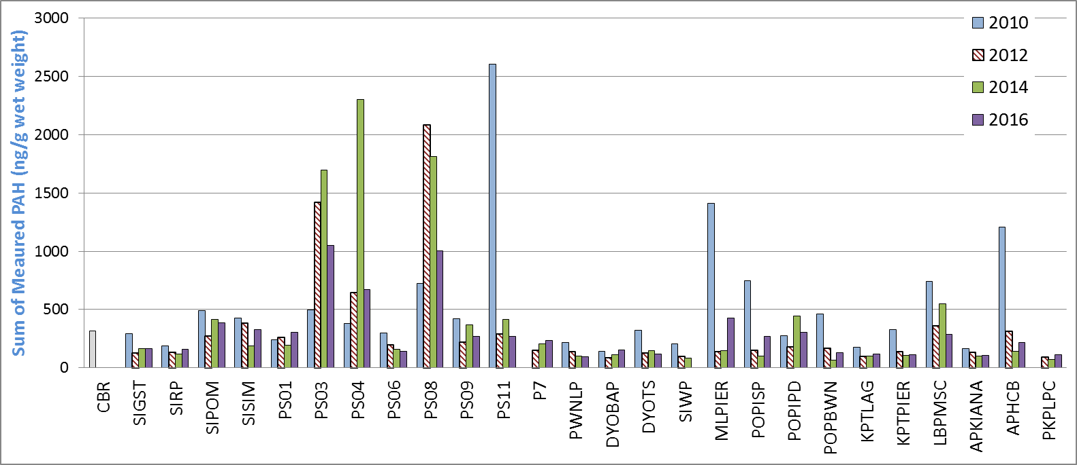
Sum PAHs – Polycyclic Aromatic Hydrocarbons
Sinclair Inlet
Navy Nearshore
Dyes I.
Passages/Liberty Bay

Slide 27
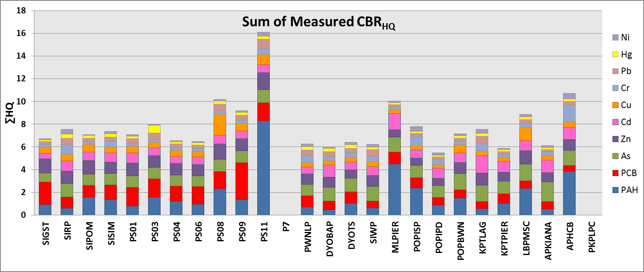
Hazard Index for Critical Body Residues 2010
Sinclair Inlet
Navy Nearshore
Dyes I.
Passages/Liberty Bay
Possible Ecological Effect – Critical Body Residue
CBR_{HQ} > 2; CBR_{HQ} = Concentration/CBR_{i}
CBR_{HI} > 10; CBR_{HI} = ΣCBR_{HQi} where i = 10

Slide 28
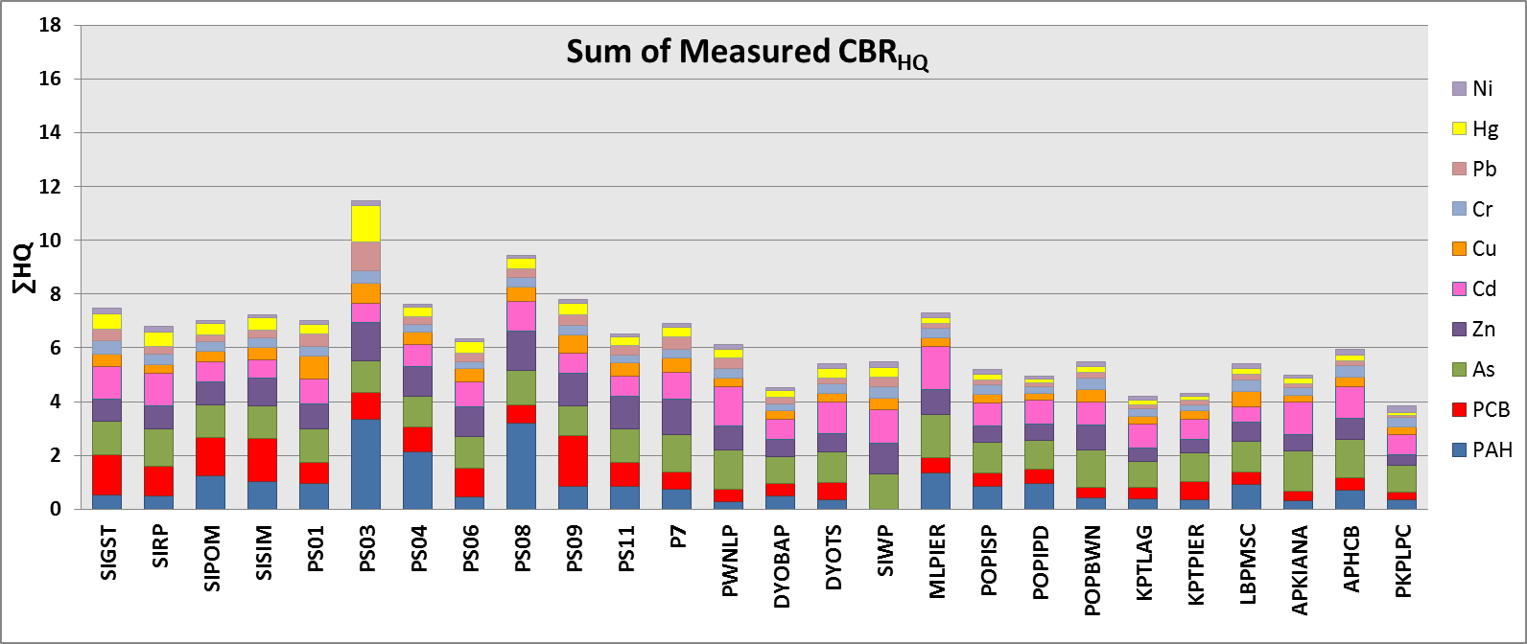
Hazard Index for Critical Body Residues 2016
Sinclair Inlet
Navy Nearshore
Dyes I.
Passages/Liberty Bay
Possible Ecological Effect – Critical Body Residue
CBR_{HQ} > 2; CBR_{HQ} = Concentration/CBR_{i}
CBR_{HI} > 10; CBR_{HI} = ΣCBR_{HQi} where i = 10

Slide 29
Conclusions
Monitoring Program is focused on tracking environmental quality in the Inlets
Can identify problems for further investigation and correction
Can be used to evaluate effectiveness of corrective actions
Ambient Monitoring and Toxicity Testing Status and Trends
Effluent quality is improving
Receiving Waters Not Toxic and Protective of Beneficial Uses
What are the Biota Telling Us?
Some Areas Elevated with PAHs, PCBs, Hg, and Cu
Overall decrease in contaminant levels indicates Improving Environmental Quality
Monitoring framework provides context for interpretation
Better information = Better management

